Slide 1
RIOT GRRRL: A Feminist revolution
https://www.youtube.com/watch?v=bOCWma5vOiQ

Slide 2
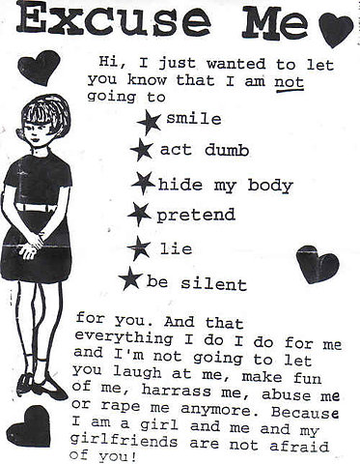
What is riot grrrl?
A movement that emerged in 1991 when a group of women in Olympia, Washington held a meeting to discuss how to address sexism in the punk scene.
Use of the word “girl” came from a desire to focus on childhood, a time when girls have the strongest self-esteem and belief in themselves.
Alternative spelling “grrrl” advertises the anger behind the movement, almost like a growl.
First zine, or fanzine, associated with movement was Riot Grrrl, which published their manifesto.
Section of manifesto:
“BECAUSE we know that life is much more than physical survival and are patently aware that the punk rock 'you can do anything' idea is crucial to the coming angry grrrl rock revolution which seeks to save the psychic and cultural lives of girls and women everywhere, according to their own terms, not ours.”

Slide 3
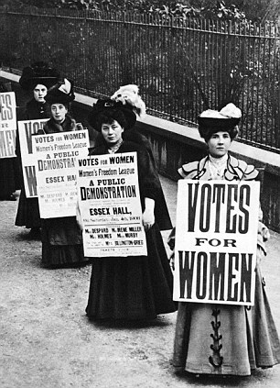
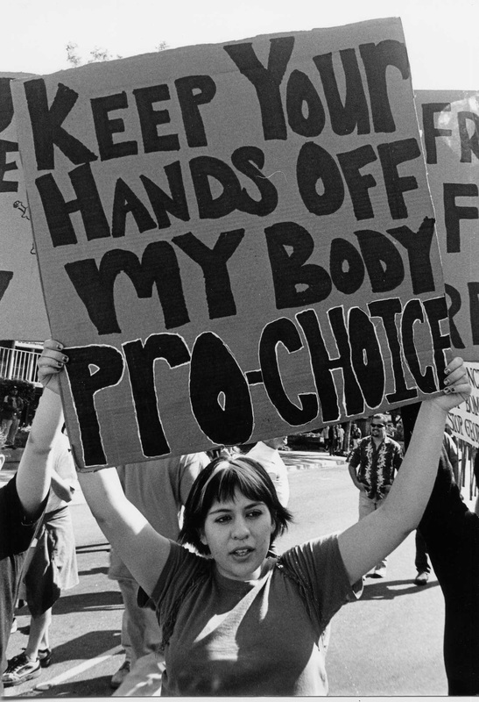
First and second waves of feminism
First wave feminism
1840s-1850s feminist reform movements that led to the Seneca Falls Convention in 1948. Focused mainly on the right of women to vote.
Mainly led by Elizabeth Cady Stanton and Lecretia Mott.
Led primarily by white women who supported restrictions based on race and property ownership.
Second wave feminism
Feminist activity that began in the 1960s and lasted until the early 1980s.
Covers a wide range of issues, such as, sexuality, family, the workplace, reproductive rights and official legal inequalities.
Criticized for ignoring the voices of women of color, working-class women and LGBT women.

Slide 4
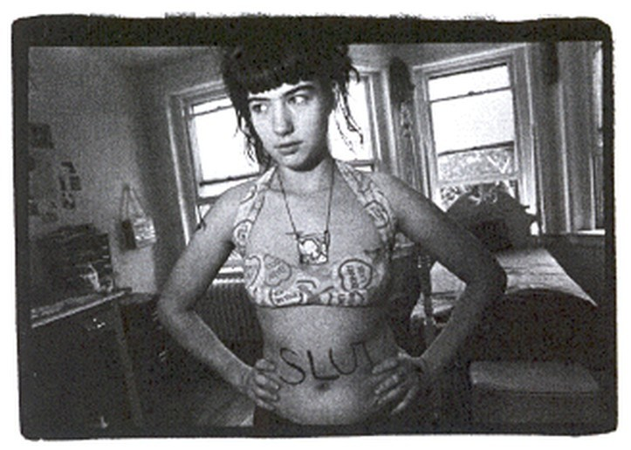
Why?
Punk-rock and rock communities were very male-driven and male-exclusive.
Women who went to concerts were forced to stand in corners holding the guys jackets as they moshed (”coathangers”).
Zines became a way for women everywhere to share their experiences of sexual assaults, eating disorders and sexism.
This helped the community realize that these occurrences were political and not isolated.
Kathleen Hanna was told by an adviser to take what she had been writing in zines and turn that into a band. This became Bikini Kill.
Songs such as “Feels Blind” speak of the way society teaches women to hate themselves:
“As a woman I was taught to always be hungry. Yeah, women are well acquainted with thirst. Well, we could eat just about anything. We might even eat your hate up like love.”

Slide 5
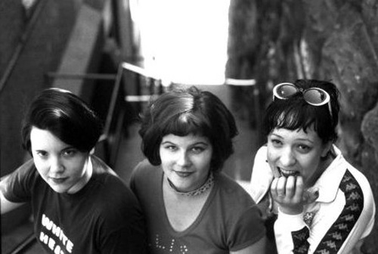
Who?
First fanzine was created by Allison Wolfe and Molly Newman, members of the band Bratmobile, and was named Riot Grrrl.
Bands who were influential to the Riot Grrrl movement were: Heavens to Betsy, Bikini Kill, Bratmobile, Babes in Toyland, Viva Knievel and many others.
These bands all wrote personal lyrics that were political and feminist statements as well.
Lyrics from ”Cool Schmool” by Bratmobile:
“I don't want you to tell me what's so cool I don't wanna go back to jr. highschool I don't want anyone to tell me how thin I am I don't want to die for your f****** candy treats”
https://www.youtube.com/watch?v=LU1bEeKsHs8 Bratmobile - Cool Schmool Lyrics | MetroLyrics

Slide 6
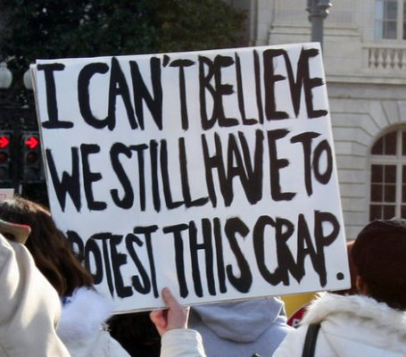
Fourth wave feminism
New wave has emerged, more tightly linked to social media and technology.
More representative of LGBT community, minorities and male feminism.
What issues do you think would be appropriate to add to the fourth wave of feminism?
Which issues are most important to you?
What do you think past waves have lacked?
Do you think the third wave of feminism was successful?
https://www.youtube.com/watch?v=c9SUAcNlVQ4

Slide 7
Cites
https://recognisethespin.files.wordpress.com/2015/10/protest.jpg?w=610
http://www.teenbeat.net/images/artists/bratmobilebx.jpg
http://dazedimg.dazedgroup.netdna-cdn.com/723/azure/dazed-prod/1110/7/1117587.jpg
http://womencivilright.weebly.com/uploads/2/5/0/3/25030318/2117320_orig.jpg
http://www.returnofkings.com/wp-content/uploads/2013/03/article-0-156B8AF8000005DC-768_306x423.jpg
https://s-media-cache-ak0.pinimg.com/originals/4b/66/20/4b6620895fe8d6cab90210f19a4febb6.jpg
http://www.feministezine.com/feminist/music/The-History-of-Riot-Grrls-in-Music.html

